Slide 1

Mastering Web Scraping for Data Extraction
Tools and techniques for collecting data from websites
Notes:
Web scraping is the process of extracting data from websites for various use cases such as market research, competitive analysis, and content aggregation. In this presentation, we will discuss the techniques, tools, and ethics involved in web scraping.

Slide 2

Agenda Items
Introduction to Web Scraping
Web Scraping Techniques
Web Scraping Tools and Libraries
Ethics and Legal Considerations in Web Scraping
Dealing with Anti-Scraping Mechanisms
Saving and Exporting Scraped Data
Handling Large-Scale Scraping
Notes:
We will start by introducing the concept of web scraping and its use cases. Then, we will dive into the techniques involved in parsing HTML and navigating through DOM structures. Next, we will explore the popular tools and libraries used for web scraping, including Python libraries like BeautifulSoup, Scrapy, and Selenium, and cloud-based scraping tools like ParseHub and Octoparse. After that, we will discuss the ethics and legal considerations involved in web scraping, such as complying with website terms of service and avoiding copyright infringement. We will also cover anti-scraping mechanisms and techniques to handle them, including CAPTCHA, IP rotation, and user-agent spoofing. Finally, we will talk about saving and exporting scraped data, as well as handling large-scale scraping jobs using distributed scraping and cloud infrastructure.

Slide 3
Introduction to Web Scraping
Notes:
Web scraping is the process of extracting data from websites using automated tools. It has various use cases such as market research, competitive analysis, and content aggregation. In this section, we will define web scraping and its purpose.

Slide 4

Definition and Purpose of Web Scraping
What is Web Scraping?
  Web scraping is an automated technique of extracting data from websites. It involves using software tools to extract data from web pages and save it in a structured format for further analysis.
Applications of Web Scraping
  Web scraping has various applications, including market research, competitive analysis, and content aggregation. It can be used to gather data on products, prices, and customer reviews, among other things.
Notes:
Web scraping is a technique of extracting data from websites using automated tools. It has various applications such as market research, competitive analysis, and content aggregation.

Slide 5

Use cases of Web Scraping
Market Research
  Web scraping can be used for market research to gather data on pricing, product features, customer reviews, and other market trends.
Competitive Analysis
  Web scraping can be used for competitive analysis to gather data on competitor pricing strategies, product features, marketing campaigns, and other key metrics.
Content Aggregation
  Web scraping can be used for content aggregation to gather articles, news, and other content from various sources to create a comprehensive database for analysis and research.
Notes:
Web scraping can be used for a variety of purposes such as market research, competitive analysis, and content aggregation. It allows businesses to gather data from various sources and make informed decisions based on that data.

Slide 6
Web Scraping Techniques
Notes:
Web scraping involves parsing HTML to extract data from web pages, navigating through DOM structures, and handling dynamic content. In this section, we will discuss the techniques involved in web scraping.

Slide 7

Parsing HTML
  Parsing HTML involves analyzing the structure of web pages to extract relevant data. This is done by identifying the relevant HTML tags and attributes, and using tools and libraries to parse and extract the data.
Notes:
Parsing HTML is the process of extracting data from web pages by analyzing their HTML structure. This involves identifying relevant HTML tags and attributes to extract the desired data.

Slide 8

Navigating through DOM structures
DOM Basics
  DOM (Document Object Model) is the hierarchical representation of a web page's HTML structure. It provides a way to manipulate the structure and content of a web page using JavaScript.
Identifying Relevant Elements
  Navigating through DOM structures involves identifying the relevant elements using selectors like id, class and tag name. This is done using JavaScript methods like getElementById, getElementsByClassName, and getElementsByTagName.
Extracting Desired Data
  Extracting desired data involves traversing the DOM structure using JavaScript methods like parentNode, previousSibling, nextSibling, and childNodes. It requires an understanding of the relationships between the elements.
Notes:
DOM (Document Object Model) is a hierarchical representation of a web page's HTML structure. Navigating through DOM structures involves identifying the relevant elements and their relationships to extract the desired data.

Slide 9

Handling dynamic content
  Dynamic content on websites is content that is generated by JavaScript or other scripting languages. Handling dynamic content involves the use of tools like Selenium to interact with the website and extract the desired data.
Notes:
Some websites use JavaScript to render their content dynamically. Handling dynamic content involves using tools like Selenium to interact with the website and extract the desired data.

Slide 10
Web Scraping Tools and Libraries
Notes:
There are various tools and libraries available for web scraping, including Python libraries like BeautifulSoup, Scrapy, and Selenium, and cloud-based scraping tools like ParseHub and Octoparse. In this section, we will discuss these tools and their features.

Slide 11
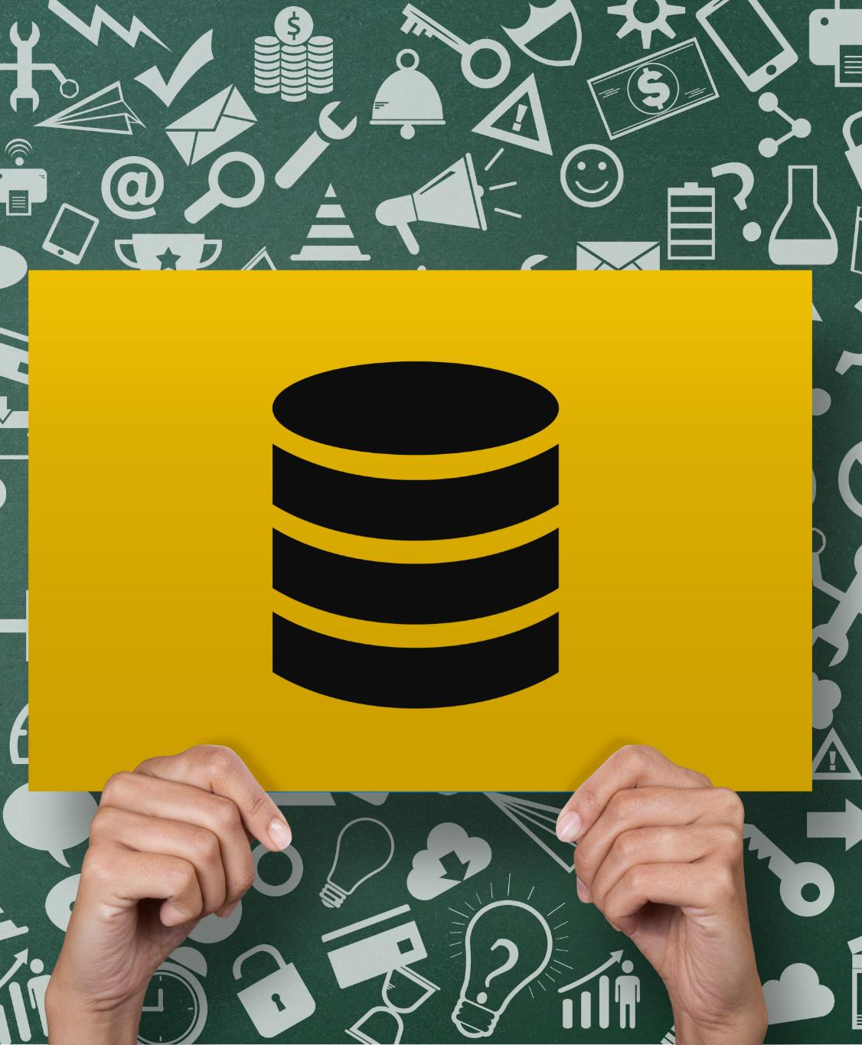
Python Libraries
BeautifulSoup
  BeautifulSoup is a popular Python library for parsing HTML and XML documents. It provides a simple interface for navigating and searching parsed documents.
Scrapy
  Scrapy is a Python framework for web scraping and crawling. It provides a powerful and flexible set of tools for extracting data from websites and other online sources.
Selenium
  Selenium is a popular tool for automating web browsers. It provides a simple and flexible way to automate repetitive tasks, such as testing and web scraping.
Notes:
Python libraries like BeautifulSoup, Scrapy, and Selenium are popular tools for web scraping. BeautifulSoup is a library for parsing HTML and XML documents, Scrapy is a framework for web scraping and crawling, and Selenium is a tool for automating web browsers.

Slide 12

Browser automation with Selenium
Browser Automation
  Selenium is a powerful tool for automating web browsers and interacting with websites. This allows developers to automate tedious tasks like filling out forms and clicking buttons, making tests more efficient and reducing the risk of human error.
Handling Dynamic Content
  Selenium is useful for handling dynamic content on web pages that change frequently. This allows developers to create robust scripts that can handle different situations on web pages.
Web Testing
  Selenium is often used for testing web applications and websites. It can be integrated with testing frameworks like JUnit and TestNG, allowing developers to create comprehensive test suites that can be run automatically.
Notes:
Selenium can be used to automate web browsers and interact with websites. It is useful for handling dynamic content and performing tasks like filling out forms and clicking buttons.

Slide 13

Cloud-based scraping tools
User-friendly Interface
  Cloud-based scraping tools like ParseHub and Octoparse offer a user-friendly interface for web scraping that allows users to create scraping projects easily and efficiently.
No Coding Required
  Cloud-based scraping tools like ParseHub and Octoparse allow users to create scraping projects without writing any code, making it easy for users with little or no coding experience to get started with web scraping.
IP Rotation and CAPTCHA Handling
  Cloud-based scraping tools like ParseHub and Octoparse offer advanced features like IP rotation and CAPTCHA handling, making it easier for users to bypass website restrictions and scrape data efficiently.
Notes:
Cloud-based scraping tools like ParseHub and Octoparse offer a user-friendly interface for web scraping. They allow users to create scraping projects without writing any code and offer features like IP rotation and CAPTCHA handling.

Slide 14
Ethics and Legal Considerations in Web Scraping
Notes:
Web scraping involves ethical and legal considerations. In this section, we will discuss the ethical and legal considerations involved in web scraping.

Slide 15

Complying with Website Terms of Service
Website Terms of Service
  Website terms of service are legal agreements between a website and its users that outline the rules and guidelines for using the website. These terms may prohibit web scraping and it is important to comply with them to avoid legal repercussions.
Complying with Terms of Service
  To comply with website terms of service, it is important to read and understand the terms before using the website. If web scraping is prohibited, it is important to avoid scraping the website to avoid legal repercussions.
Notes:
Many websites have terms of service that prohibit web scraping. It is important to comply with these terms to avoid legal repercussions.

Slide 16

Handling rate limits and avoiding IP blocking
  It is important to handle rate limits and anti-scraping mechanisms carefully to avoid being blocked from the website. One should follow the rules set by the website and avoid sending too many requests in a short period of time.
Notes:
Some websites have rate limits and anti-scraping mechanisms that can result in IP blocking. It is important to handle these mechanisms carefully to avoid being blocked from the website.

Slide 17

Ethical data scraping and avoiding copyright infringement
  Web scraping can raise ethical concerns, especially when it comes to personal data and copyright infringement. It is important to scrape data ethically and avoid infringing on copyright.
Notes:
Web scraping can raise ethical concerns, especially when it comes to personal data and copyright infringement. It is important to scrape data ethically and avoid infringing on copyright.

Slide 18
Dealing with Anti-Scraping Mechanisms
Notes:
Anti-scraping mechanisms such as CAPTCHA, IP rotation, and user-agent spoofing can make web scraping challenging. In this section, we will discuss the techniques to handle these mechanisms.

Slide 19

Managing CAPTCHA
CAPTCHA as an Anti-Scraping Mechanism
  CAPTCHA is a widely used anti-scraping mechanism that presents users with a challenge to prove they are human. This helps protect websites from malicious bots and ensures that only genuine users can access the site's resources.
DeathByCaptcha
  DeathByCaptcha is a CAPTCHA management tool that automates the process of solving CAPTCHAs. It provides a reliable and cost-effective solution for managing CAPTCHAs on websites and allows users to focus on other tasks.
AntiCaptcha
  AntiCaptcha is another CAPTCHA management tool that automates the process of solving CAPTCHAs. It is fast, reliable and supports a wide range of CAPTCHA types and APIs, making it suitable for various web applications.
Notes:
CAPTCHA is a common anti-scraping mechanism that involves presenting users with a challenge to prove they are human. CAPTCHA can be managed using tools like DeathByCaptcha and AntiCaptcha.

Slide 20

IP rotation and user-agent spoofing
IP Rotation
  IP rotation is a technique used to avoid anti-scraping mechanisms by continually changing the IP address used for scraping. This can be done using a proxy network, VPN or similar services.
User-agent Spoofing
  User-agent spoofing is a technique used to avoid being detected as a scraper by changing the user-agent string. This can be done using browser plugins or scripting tools, or by changing the headers of HTTP requests.
Notes:
IP rotation involves using multiple IP addresses to avoid being blocked by anti-scraping mechanisms. User-agent spoofing involves changing the user-agent string to avoid being detected as a scraper. These techniques can be used to avoid anti-scraping mechanisms.

Slide 21
Saving and Exporting Scraped Data
Notes:
After scraping data from websites, it is important to save and export the data for analysis. In this section, we will discuss the techniques for saving and exporting scraped data.

Slide 22
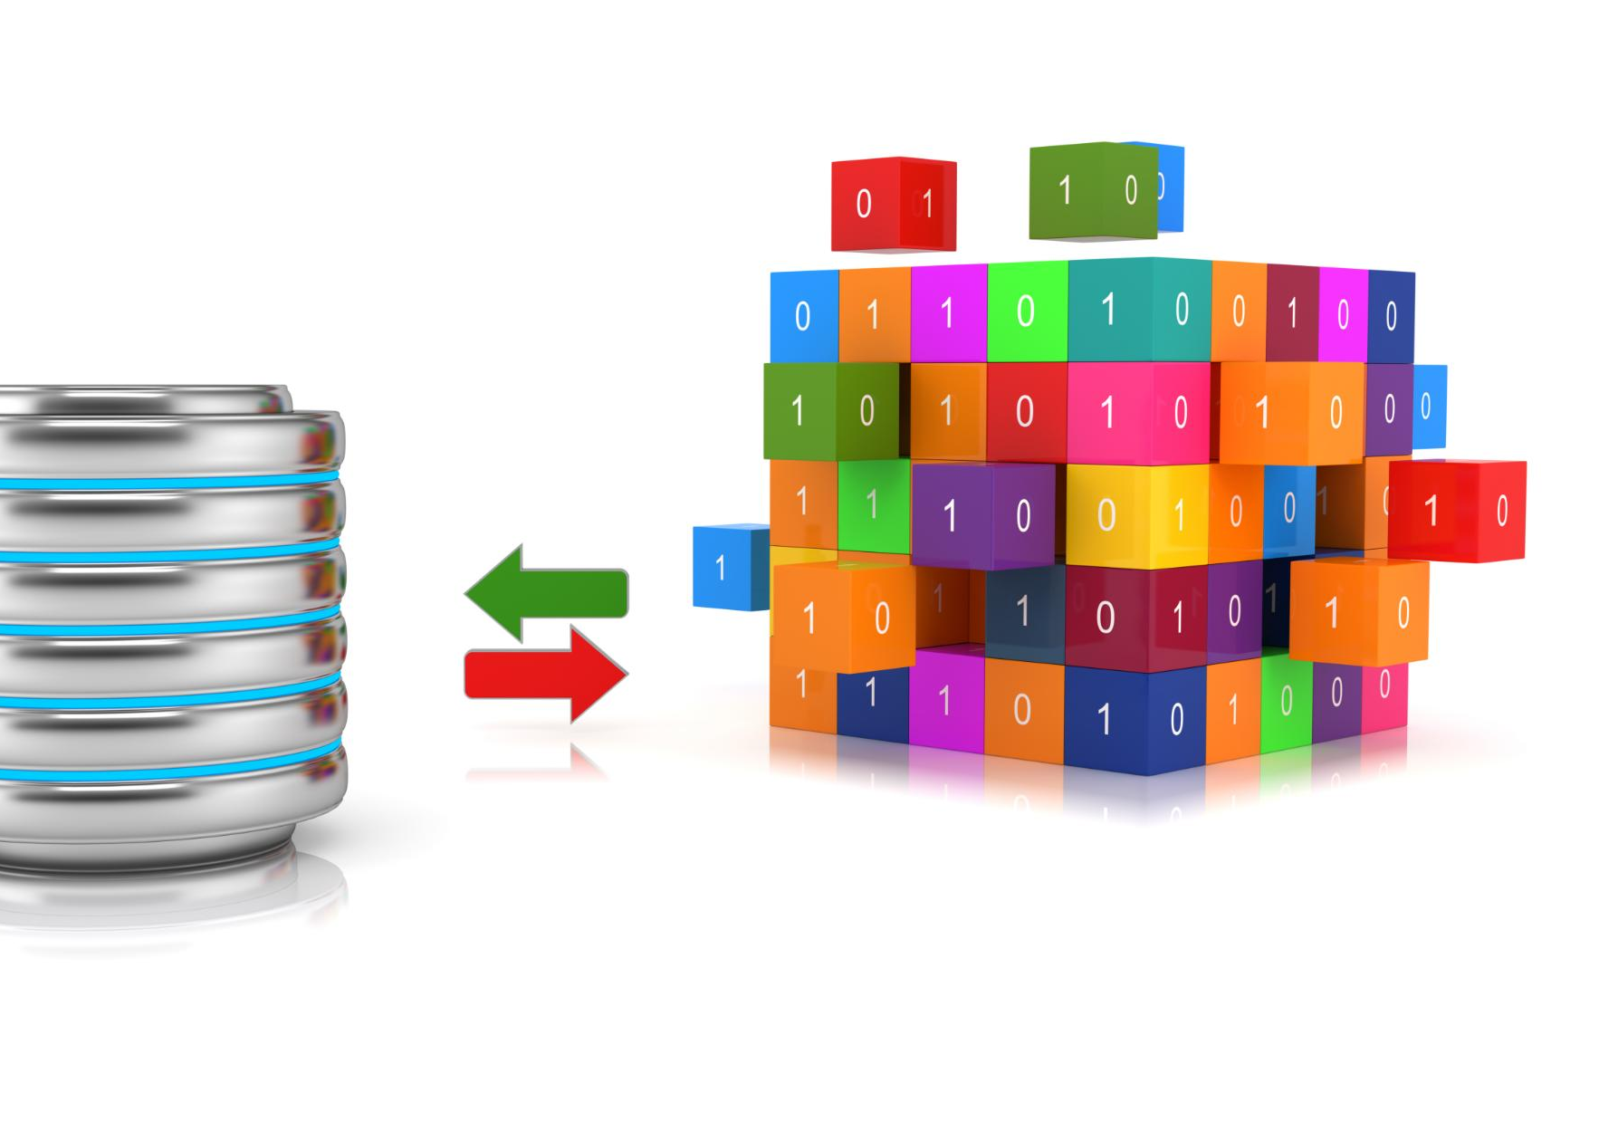
Storing Scraped Data
  Scraped data can be stored in various formats such as CSV, JSON, or databases depending on the nature of the data and the intended use.
Notes:
Scraped data can be stored in various formats such as CSV, JSON, or databases. The choice of format depends on the nature of the data and the intended use.

Slide 23

Data cleaning and processing post-scraping
  Data cleaning and processing is an important step in data analysis. It involves removing duplicates, correcting errors, and formatting data for analysis. This ensures that the data is accurate and consistent, and can be used effectively for analysis.
Notes:
Scraped data may require cleaning and processing before analysis. This involves removing duplicates, correcting errors, and formatting data for analysis.

Slide 24
Handling Large-Scale Scraping
Notes:
Large-scale scraping jobs can be challenging to handle. In this section, we will discuss the techniques for handling large-scale scraping.

Slide 25

Distributed Scraping and Parallel Processing
  Distributed scraping and parallel processing can significantly increase the speed of large-scale scraping jobs. This involves using multiple machines to scrape data in parallel, which can lead to faster data retrieval and more efficient processing.
Notes:
Distributed scraping and parallel processing can be used to speed up large-scale scraping jobs. This involves using multiple machines to scrape data in parallel.

Slide 26
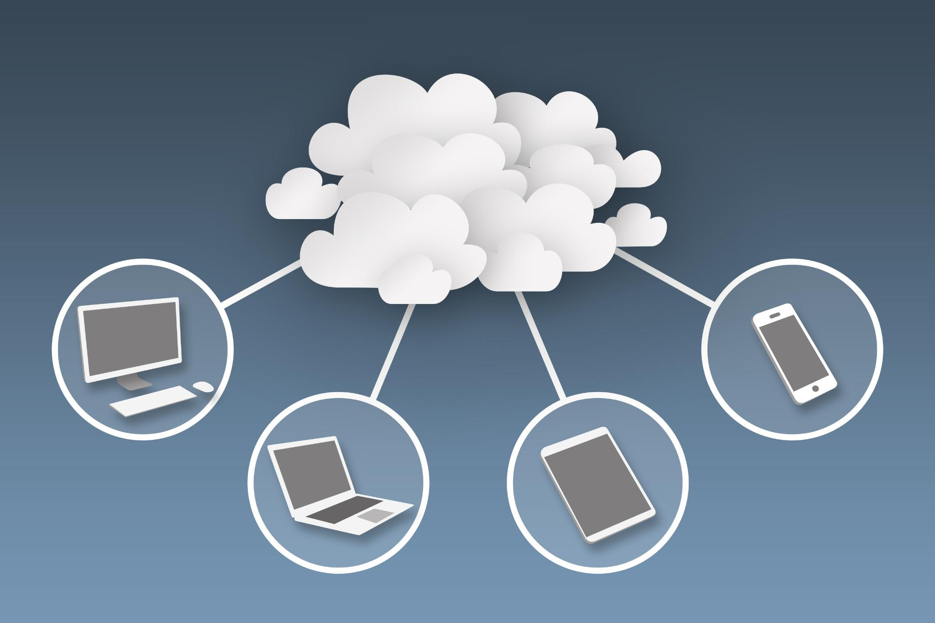
Use of Cloud Infrastructure for Large Scraping Jobs
  Cloud infrastructure provides on-demand computing resources that can be used to handle large-scale scraping jobs. This allows users to scale up their operations as needed and complete their scraping tasks efficiently.
Notes:
Cloud infrastructure can be used to handle large-scale scraping jobs by providing on-demand computing resources. This allows users to scale up their scraping jobs as needed.

Slide 27
Conclusion
  By using web scraping techniques, tools and ethical practices, businesses can extract valuable data insights and make informed decisions based on that data to stay ahead of the competition.
Notes:
Web scraping is a valuable technique for extracting data from websites for various use cases. By using the techniques, tools, and ethics discussed in this presentation, businesses can gather valuable insights and make informed decisions based on that data.

